Slide 1

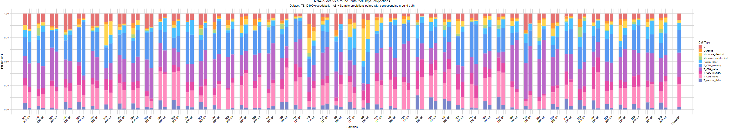
Benchmarking of Bulk RNA-seq Deconvolution Models
Pierre Lorthiois
08/04/2025
1

Slide 2
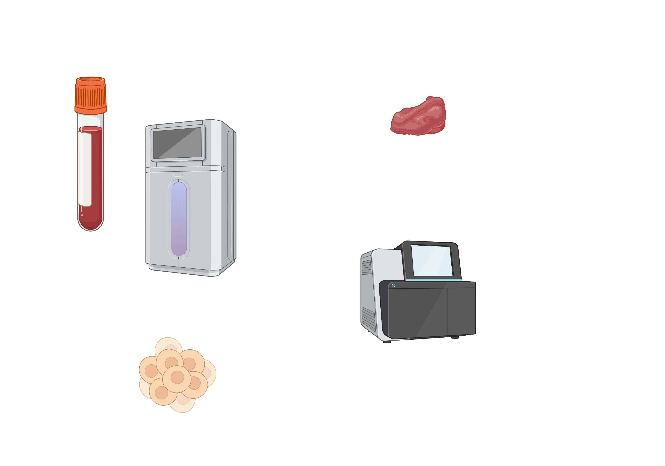
Deconvolution
Deconvolution = “Unmixing” data
Bulk RNA Single Cell RNA
2
Notes:
Not true Single Cell → Cell type proportions

Slide 3
Bulk RNA-seq Deconvolution
Single-cell RNA-seq
Cells
Genes
Cell types
Must be from similar tissues
Bulk RNA-seq
Results
Cells
Samples
Genes
Cell type proportions
Deconvolution
3

Slide 4
Why deconvolve Bulk RNA-seq ?
Bulk RNAseq: Single Cell RNAseq:
$300-$1’000/sample $2’000-$5’000/sample (10’000 cells)
100’000s samples available High Resolution: rare cell type & diseases
https://www.biotech.cornell.edu/core-facilities-brc/services
https://www.10xgenomics.com/products/universal-three-prime-gene-expression
https://genohub.com/ngs/#q=1e9e848a2a
https://www.ebi.ac.uk/biostudies/arrayexpress/studies
https://bigomics.ch/blog/ultimate-guide-to-public-rnaseq-and-sc-rna-seq-databases/
4
Notes:
Title: why Sources

Slide 5
Review: “Fourteen years of cellular deconvolution: methodology, applications, technical evaluation and outstanding challenges.”
Benchmarking of 50+ models:
Different tissues
No infectious diseases → Tuberculosis?
No cell down sampling → Different sized reference?
Only pseudobulk → Real life bulk RNA-seq?
Comes with DeconBenchmark R package to run models
One function fits all → Let’s build around it
No benchmarking
No debugging → Must build these
R package on GitHub:
https://github.com/tinnlab/DeconBenchmark
Nguyen, H., Nguyen, H., Tran, D., Draghici, S., & Nguyen, T. (2024). Fourteen years of cellular deconvolution: methodology, applications, technical evaluation and outstanding challenges. Nucleic Acids Research, 52(9), 4761-4783. https://doi.org/10.1093/nar/gkae267
5
Notes:
These models can vary widely according to conditions.
Text by text animation

Slide 6


Pseudobulk Concept
Single-cell RNA-seq
Cell1, Cell2, Cell3, Cell4
ENSG00000290825,2214, + 0, 4, + 4
ENSG00000278457, 1, + 2, 33, + 1
Pseudobulk RNA-seq
ENSG00000290825, 2214, 8
ENSG00000278457, 3, 34
6
Notes:
Pseudobulk = aggregation of single cell gene expression among a sample

Slide 7
I-Pipeline
7

Slide 8

Overview
Single-cell RNA-seq
Ground-Truth
Cells
Samples
Cell type proportions
Genes
Benchmarking
24 people
Cell types
before & after treatment
→ 48 samples
Bulk RNA-seq
Results
Cells
Samples
Genes
Cell type proportions
Deconvolution
8

Slide 9
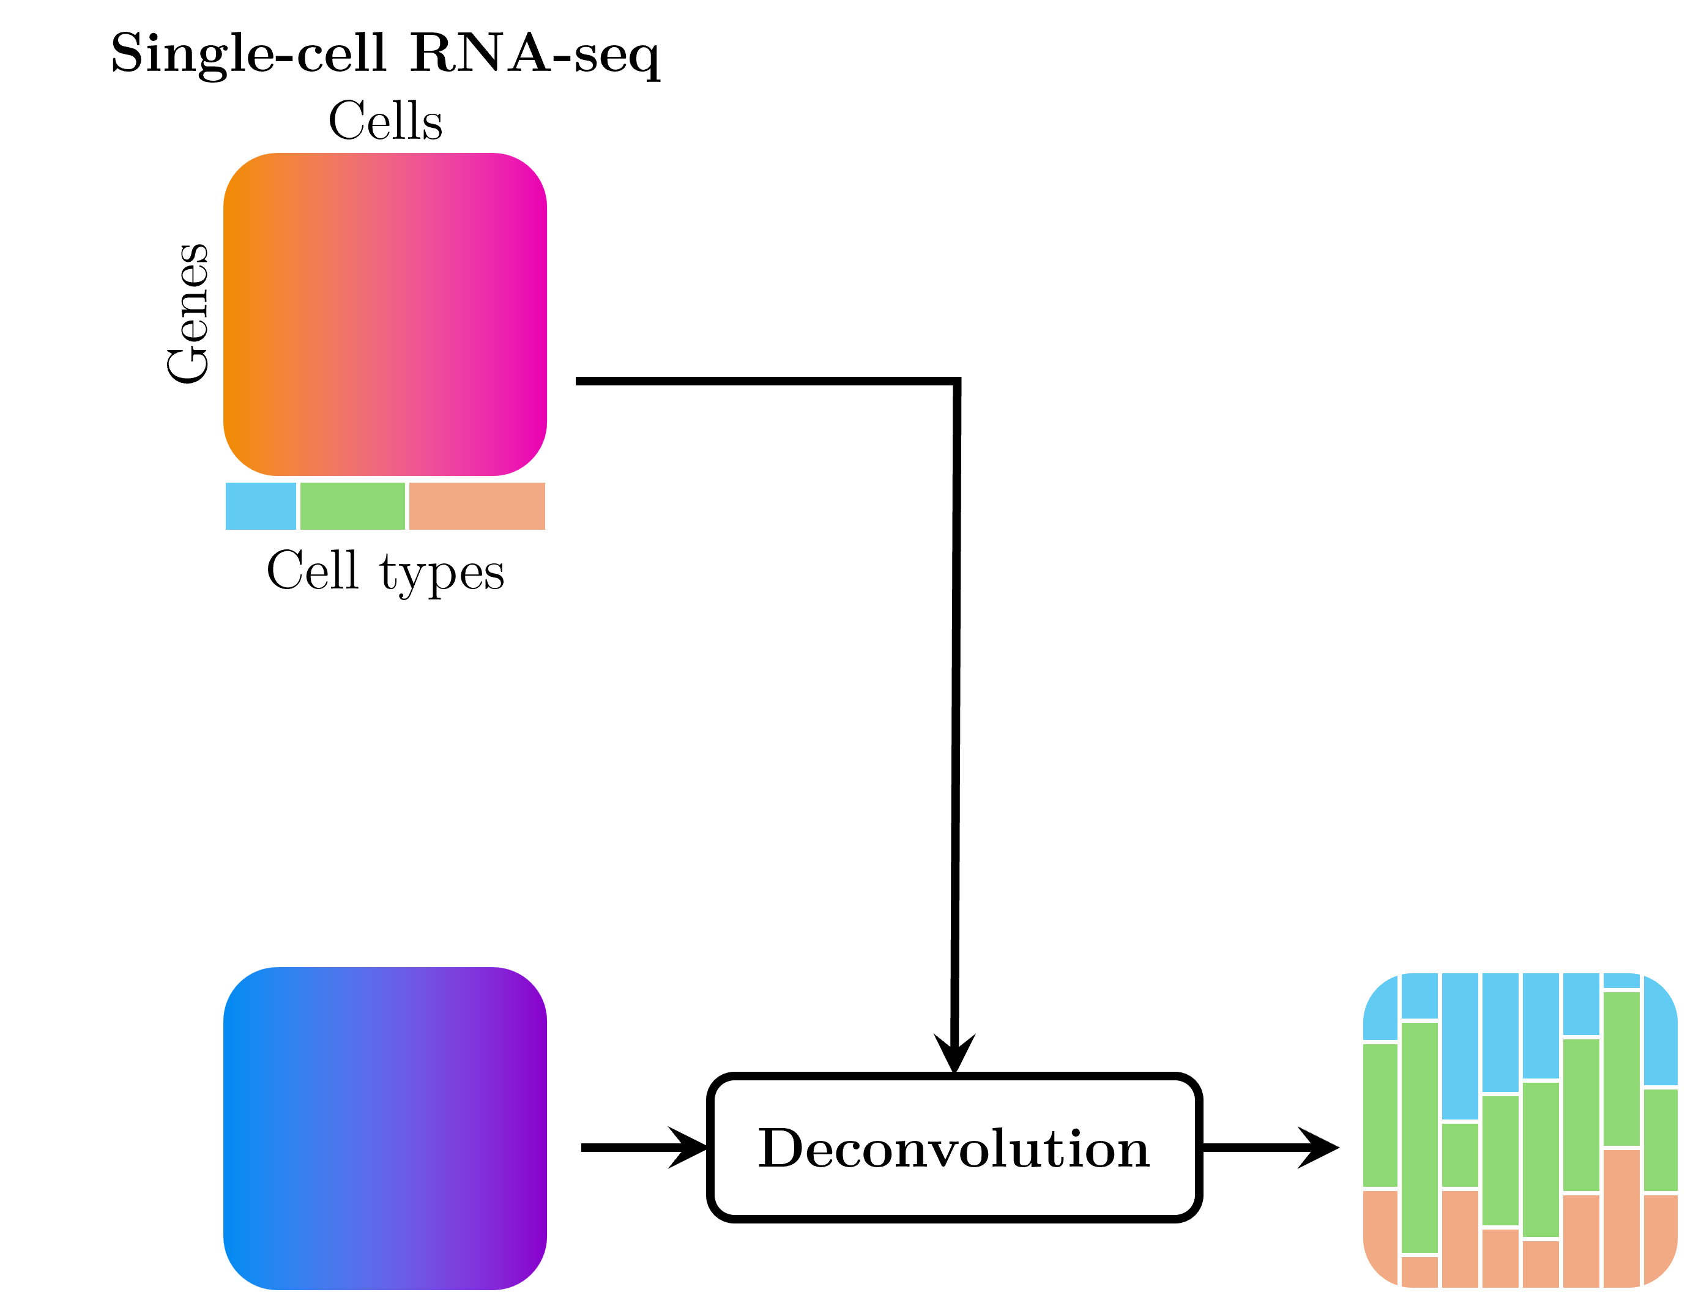
Reference Preparation
Filtering
New scRNA
Gene name mapping:
5S_rRNA → ENSG00000278457
Duplicate genes summing:
ENSG00000290825,2214,0, 4,4
+
ENSG00000290825, 1,2,33,1
=
ENSG00000290825,2215,2,37,5
Cell Expression
scRNA
Cell Labels
Cell Subjects
9
Notes:
Make data compatible for DeconBenchmark function.

Slide 10
Deconvolution
Single-cell RNA-seq
Cells
Genes
Cell types
Bulk RNA-seq
Deconvolution
Results
Cells
Samples
Gene filtering
Genes
Cell type proportions
DeconBenchmark(bulkRNA,scRNA)
10
Notes:
Keep only genes in common in the two datasets. Make them match as much as possible.

Slide 11
Benchmarking
Ground Truth
Metrics
JSD
(Mean & SD)
R2
(Mean & SD)
Pairing samples
Pearson Corr.
(Mean & SD)
NRMSE
(Mean & SD)
Results
11
Notes:
Pair each predicted sample with its corresponding GT sample. Compute the metrics, mean, and plot.

Slide 12
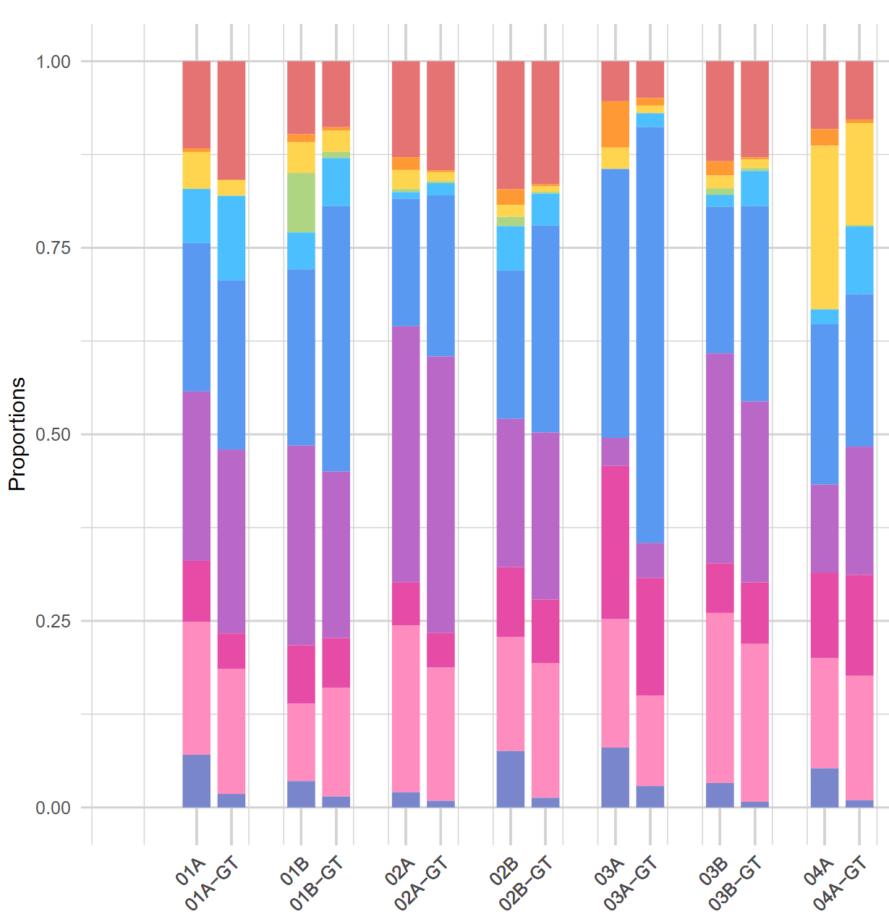
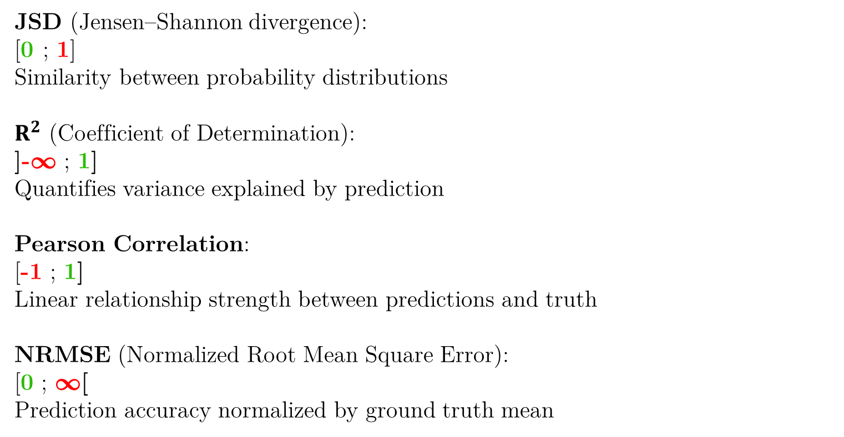
Benchmarking Metrics
JSD (Jensen–Shannon divergence):
[0 ; 1]
Similarity between probability distributions
$R^{2}$ (Coefficient of Determination):
]-∞ ; 1]
Quantifies variance explained by prediction
Pearson Correlation:
[-1 ; 1]
Linear relationship strength between predictions and truth
NRMSE (Normalized Root Mean Square Error):
[0 ; ∞[
Prediction accuracy normalized by ground truth mean
12
Notes:
JSD:
“Does it find the right cell types at the right proportions?” More sensitive to errors in distribution shape, especially for rare cell types
Measures how much information is lost using your prediction
Penalizes hallucinations.
R2:
"What fraction of the variance is captured by the predictions?“
Good for comparing overall fit quality
0 indicates the model performs no better than simply predicting the mean value.
Using the regression outputs:
R² = 1 - (SSE / TSS),
SSE (Sum of Squared Errors): sum((gt_vector - pred_vector)^2),
TSS (Total Sum of Squares): sum((gt_vector - mean(gt_vector))^2)
While cell proportions violate the independence assumption due to their compositional nature, all methods are evaluated under the same constraint, allowing fair comparison, which is why we also use multiple metrics like JSD that are designed for comparing distributions
NRMSE:
"What is the typical magnitude of prediction error?"
Normalization → Increase error value when more cell types (the more the cell types, the more drastic the error)
→ Prevents rare cell-types from being underweighted
Squaring → Penalizes more large errors

Slide 13
Radar Chart Reading
R2
Individual scales
Outside = better
1
JSD
0
0.7
-10
-1
Pearson Corr.
4
1
3600s
0
NRMSE
0s
Runtime
13

Slide 14
Parallel Deconvolution
Single-cell RNA-seq
Deconvolution
Bulk RNA-seq
Results
Deconvolution
Deconvolution
etc.
etc.
14
Notes:
Maybe just say it. Put Disclaimer pipeline title (hard work)

Slide 15
Parallel Run Debugging
Single-cell RNA-seq
Deconvolution
Bulk RNA-seq
Job mapping
file
Deconvolution
Deconvolution
Error summary file
etc.
15

Slide 16
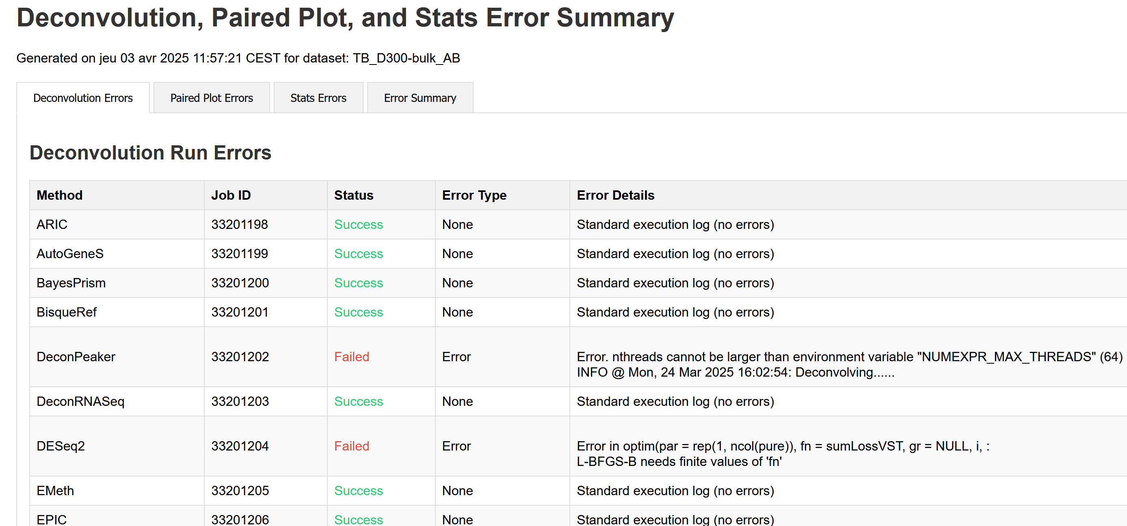
Parallel Run Debugging
Error summary file
16
Notes:
2 slides

Slide 17
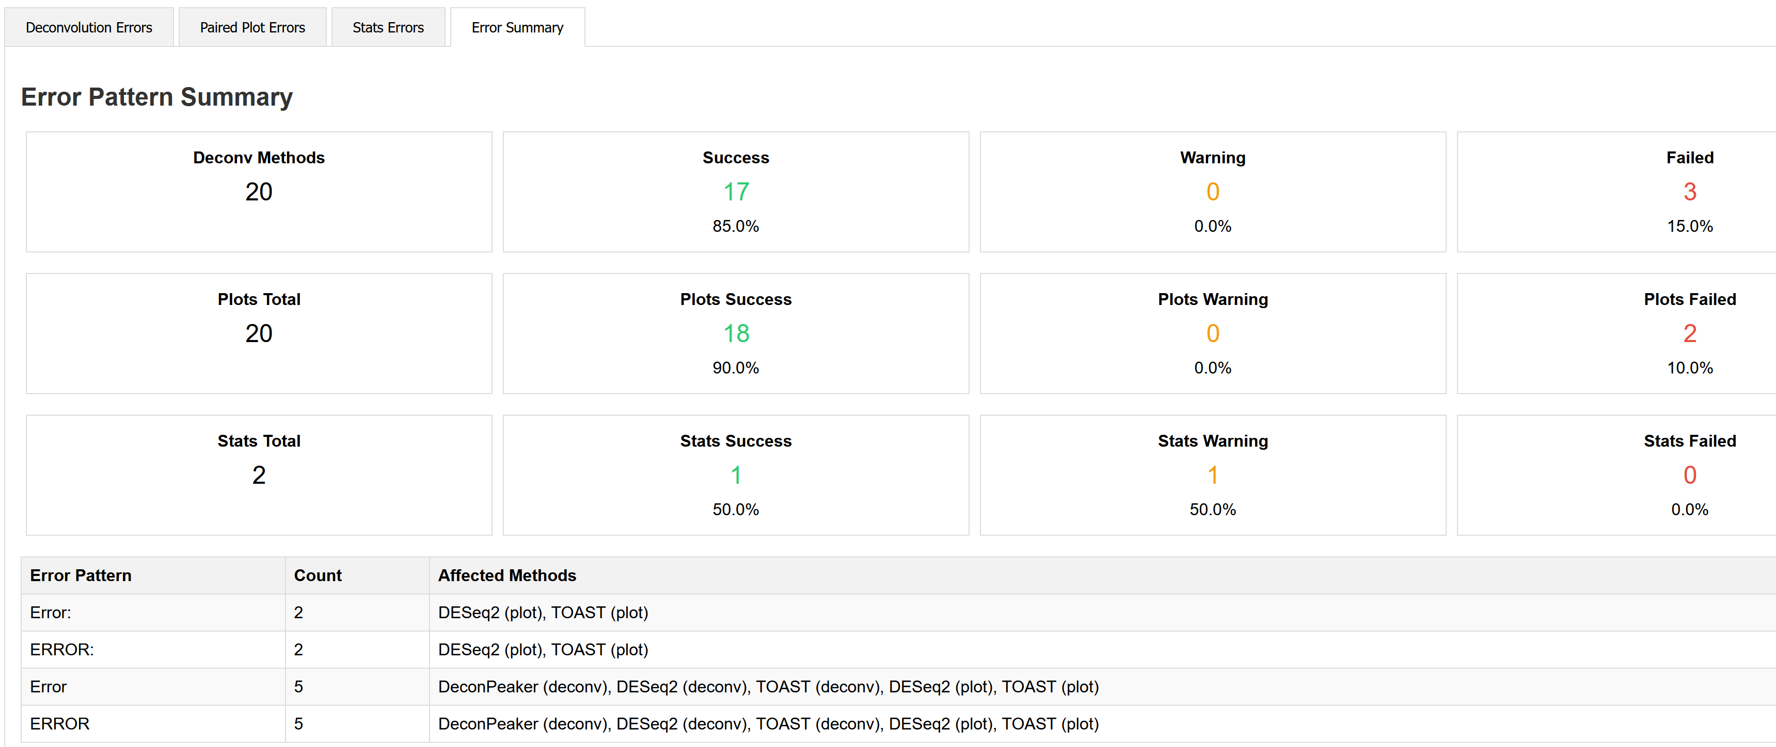
Parallel Run Debugging
Error summary file
17
Notes:
2 slides

Slide 18
II-Results
18

Slide 19
What Impact of Bulk Quality ?
Single-cell
Bulk
Parallel Deconv.
etc.
Pseudobulk
Results
Parallel Deconv.
etc.
Random Bulk
Parallel Deconv.
etc.
19
Notes:
Introduce pseudobulk

Slide 20
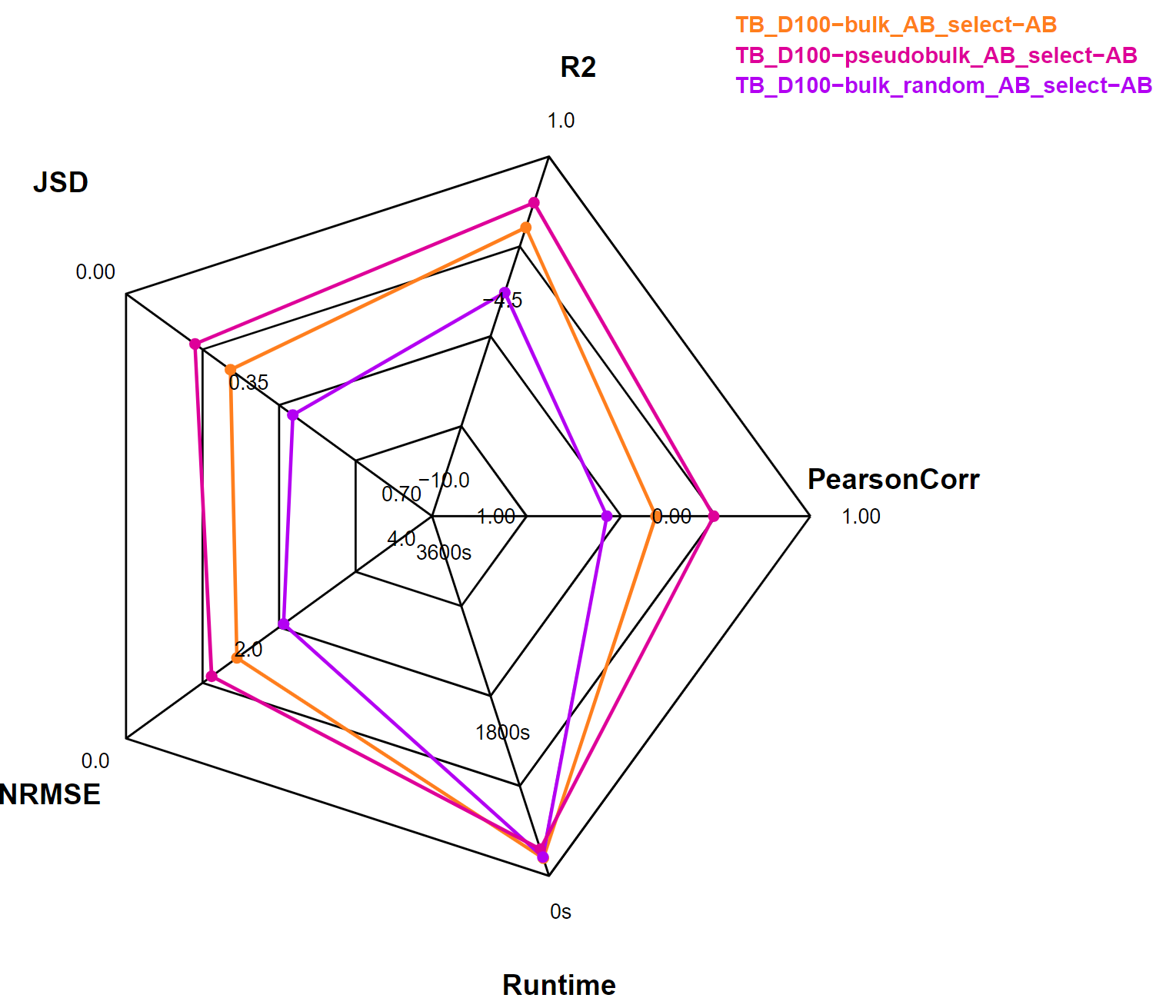
Bulk Comparison
Results
20

Slide 21
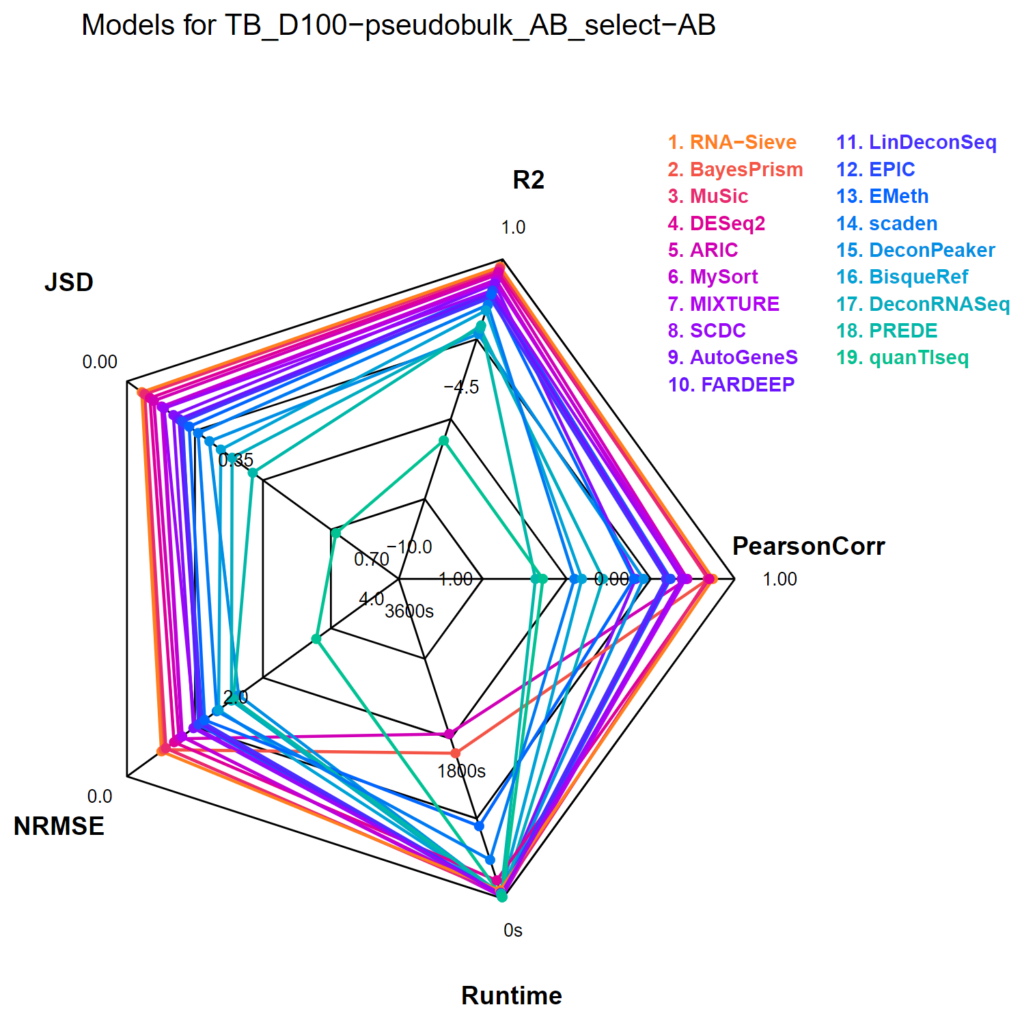
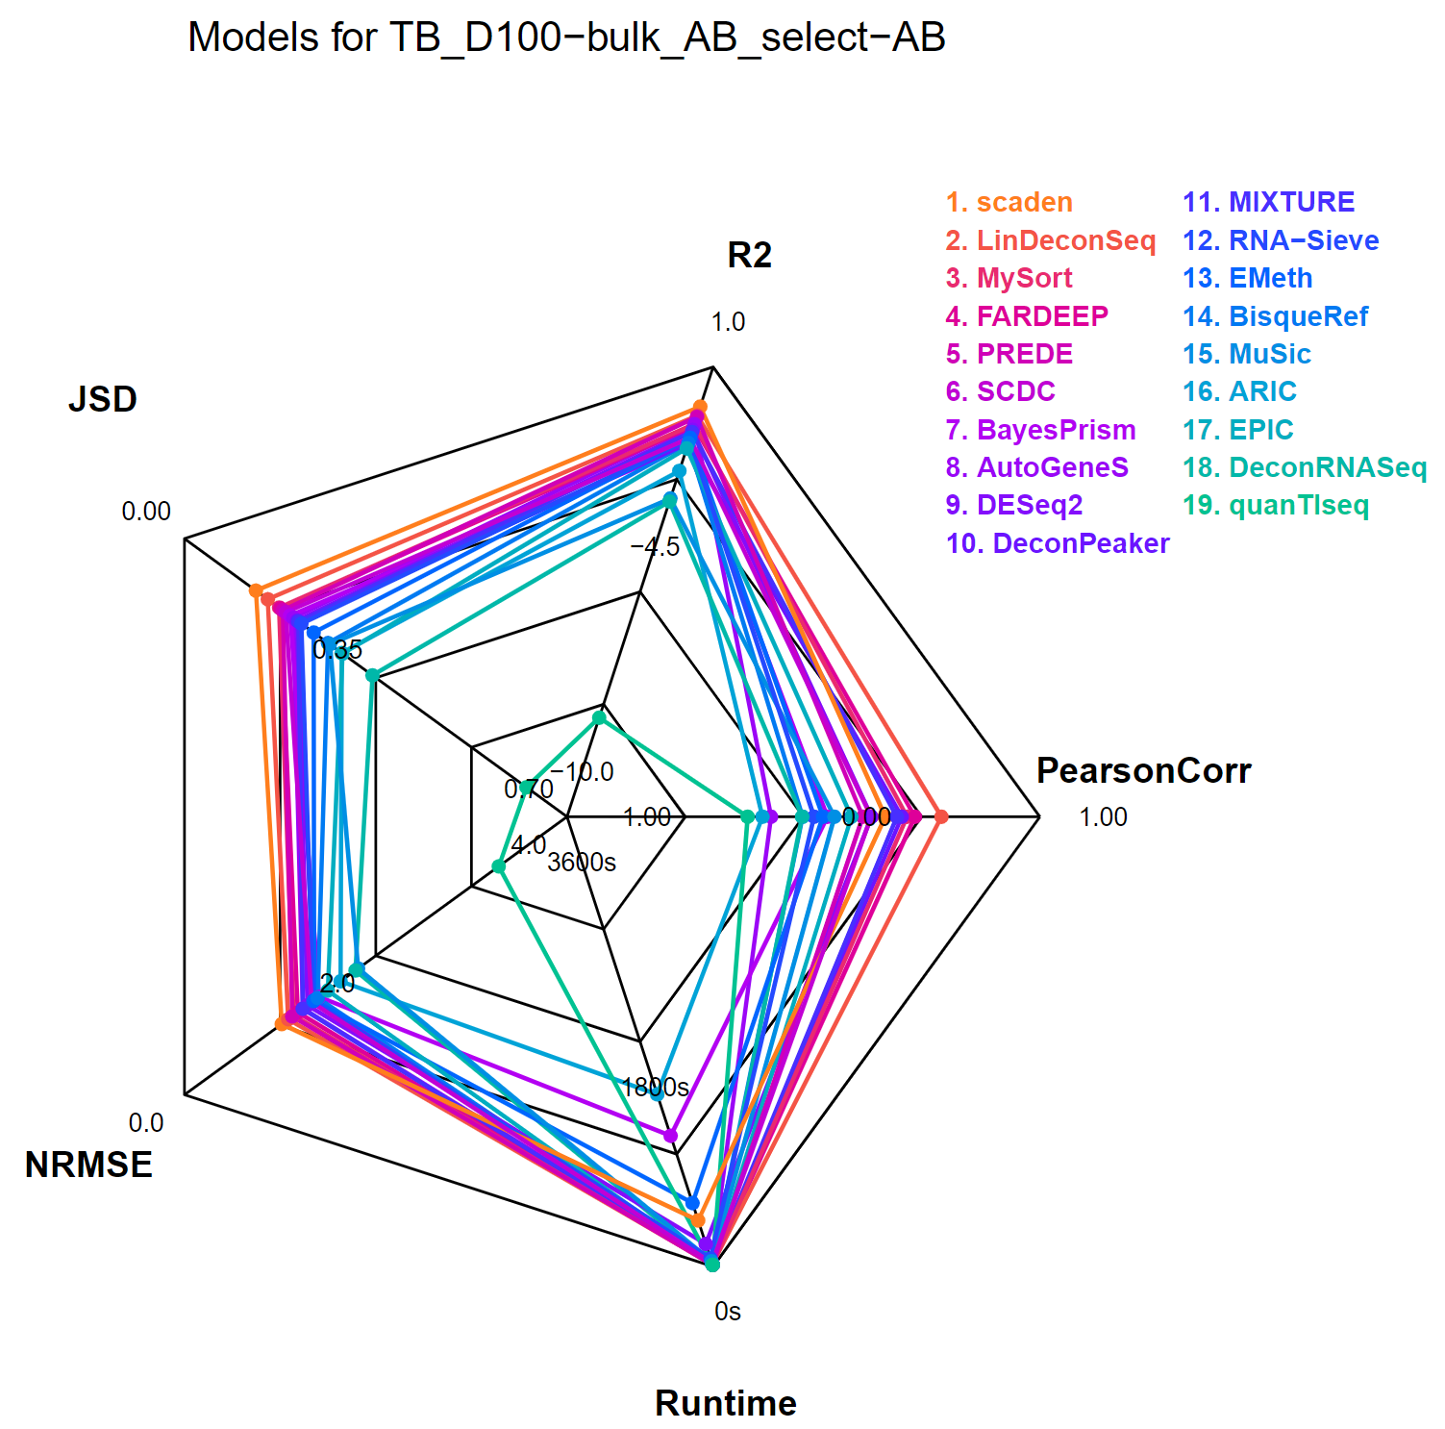
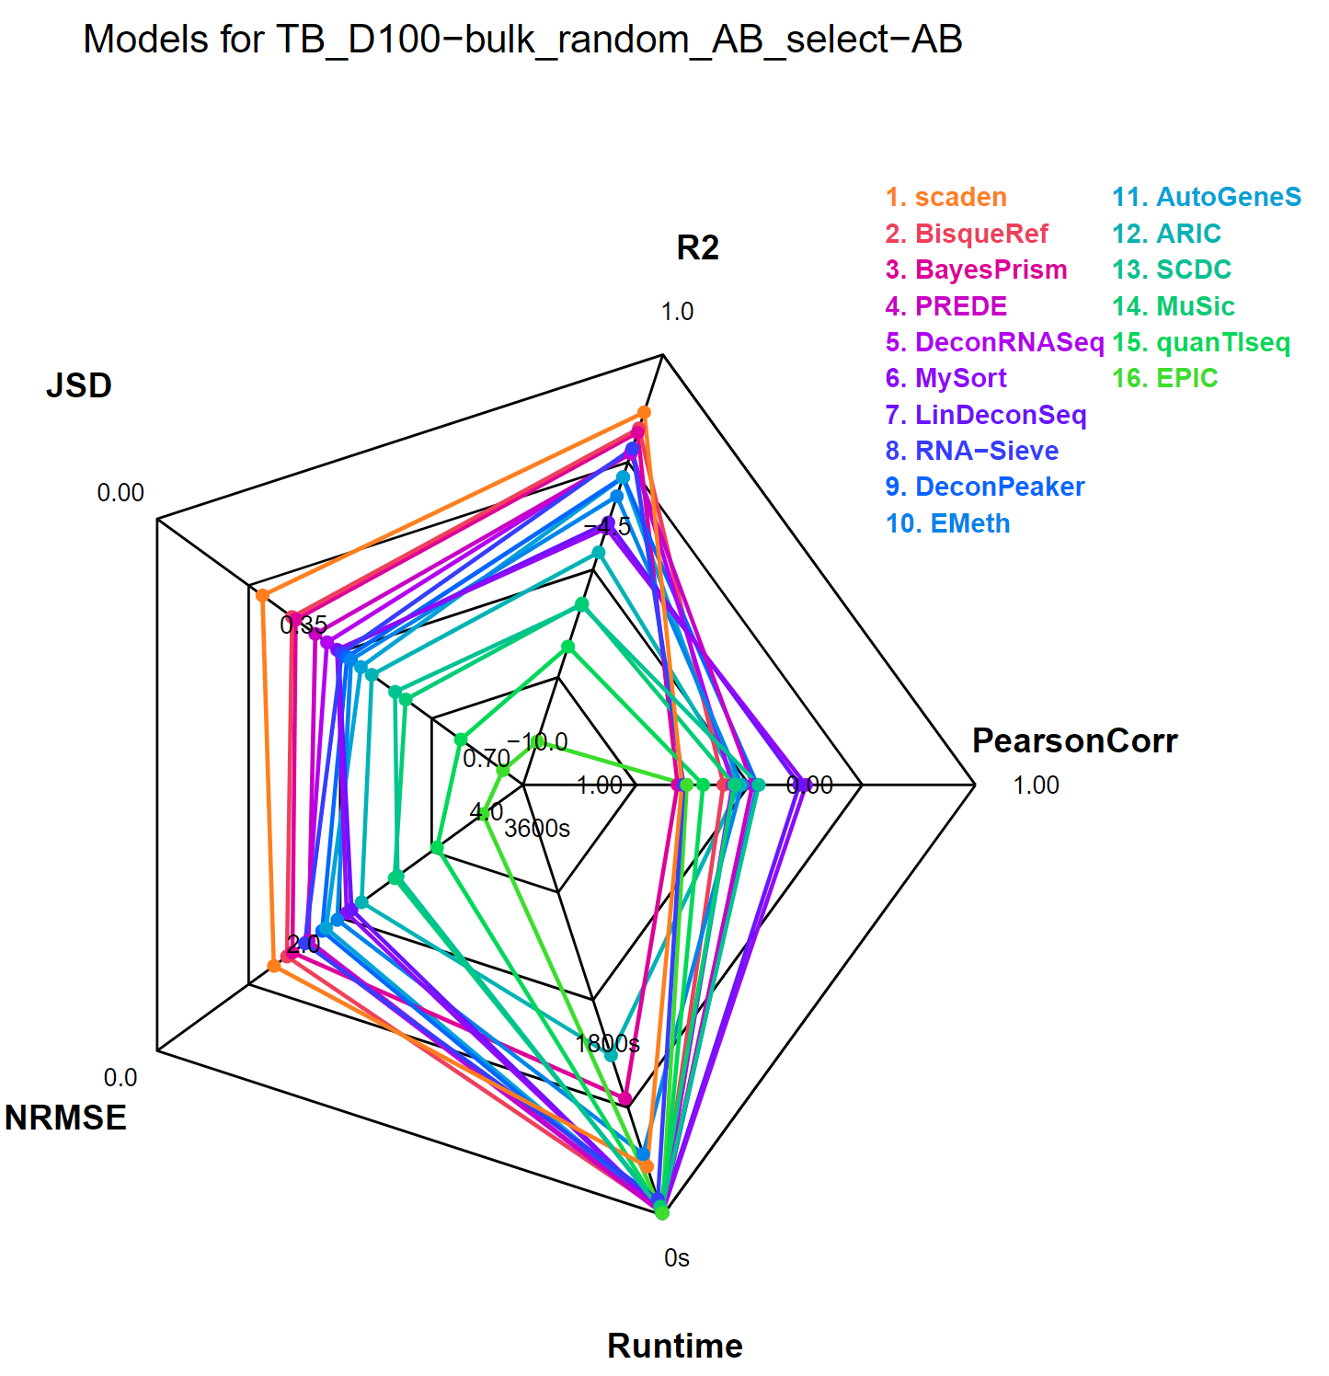
Bulk Comparison
Pseudobulk Bulk Random Bulk
21

Slide 22
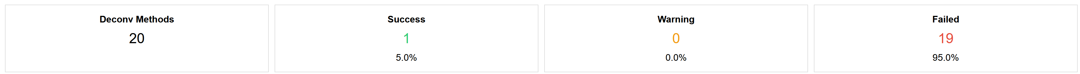
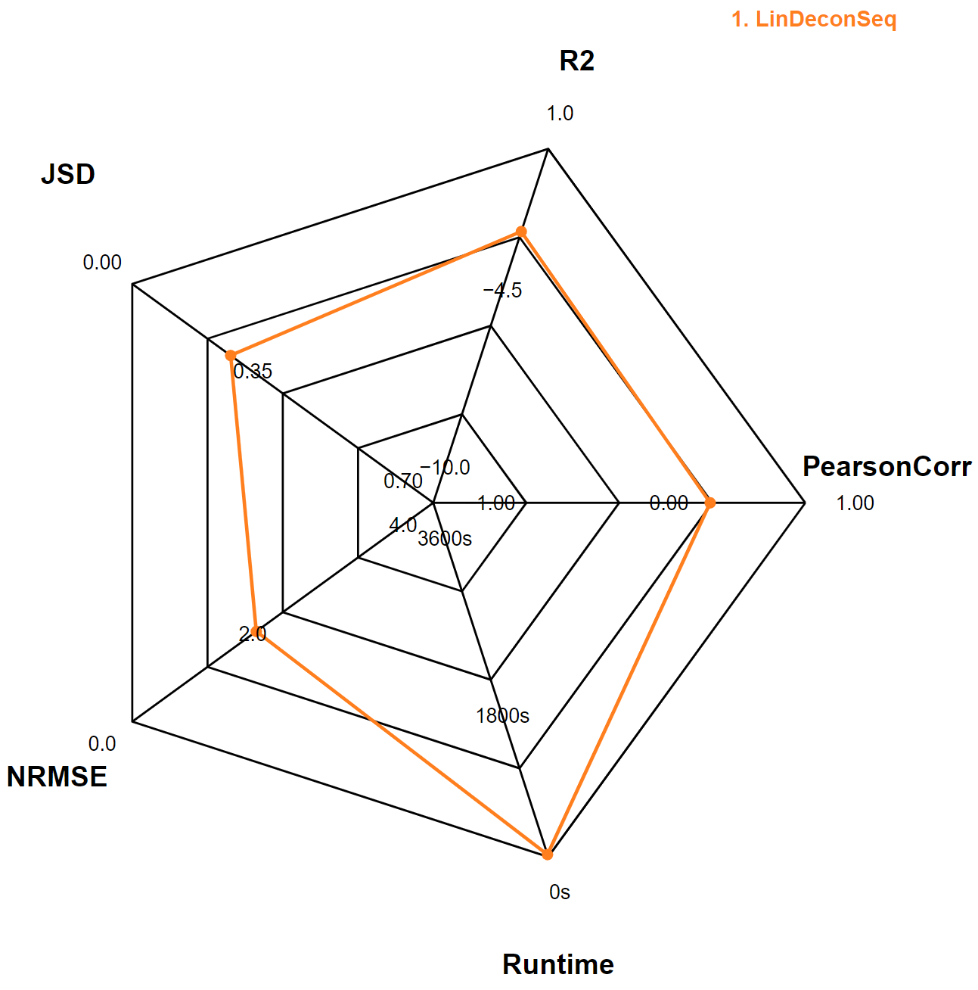
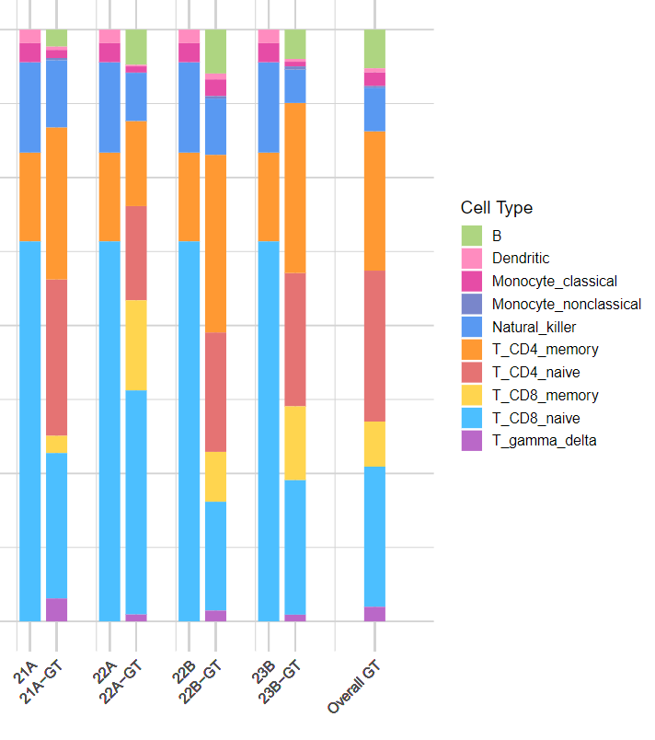
Null Bulk
LinDeconSeq results
22

Slide 23
What Impact of Reference Size ?
sc all cells
sc 100 cells
Parallel Deconv.
Results
etc.
sc 10’000 cells
Parallel Deconv.
etc.
Bulk
23

Slide 24
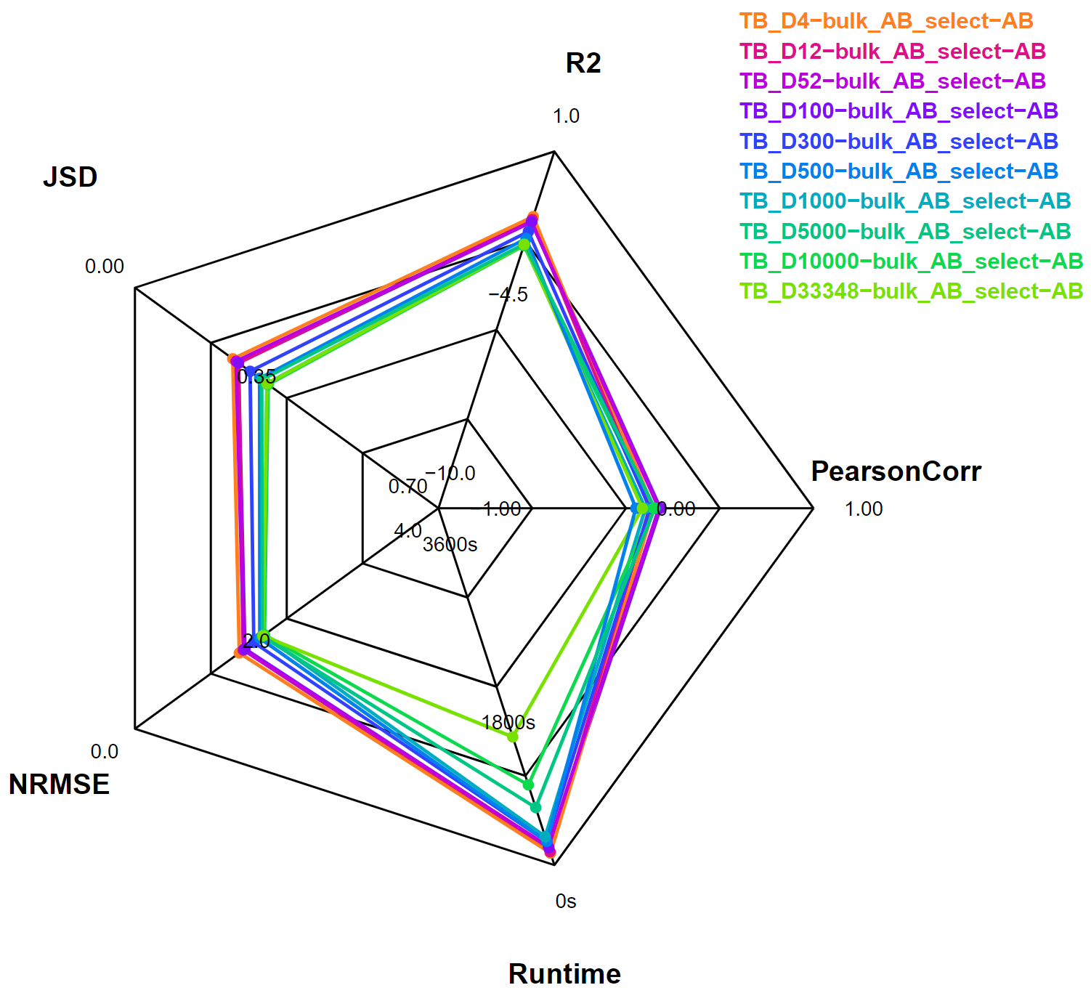
Number of Cells Comparison
Results
Cells/cell type
24
Notes:
Title = question

Slide 25
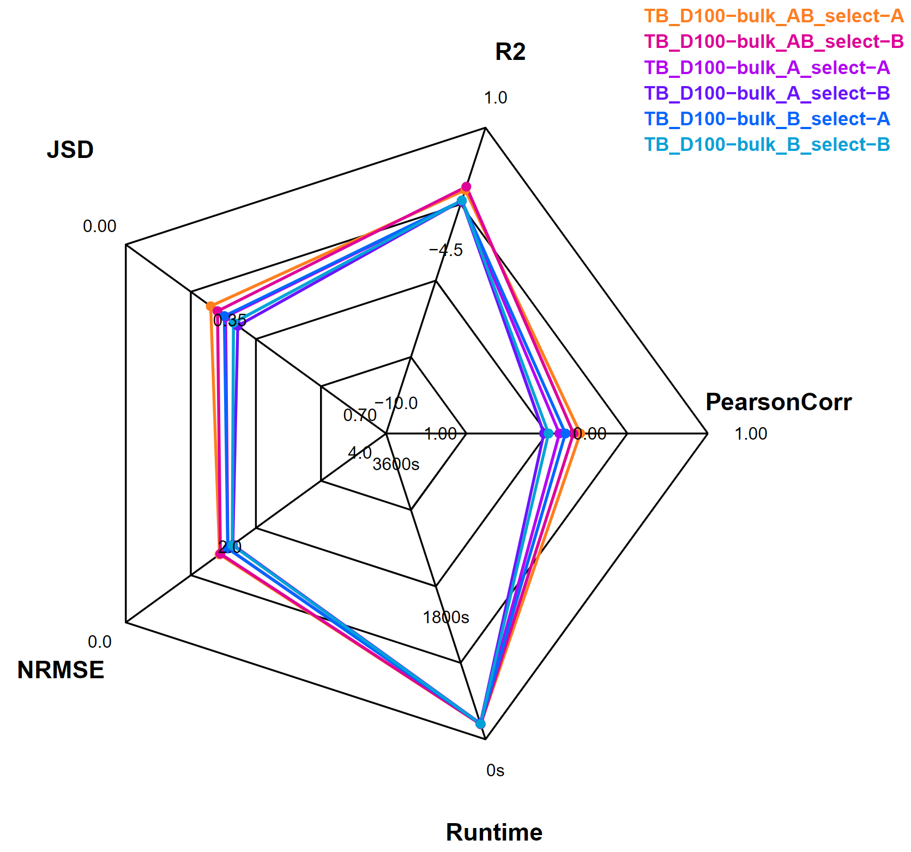
Results
What Impact of Infectious Diseases?
Reference samples
Evaluated samples
A: Untreated Tuberculosis
B: Treated Tuberculosis
25

Slide 26
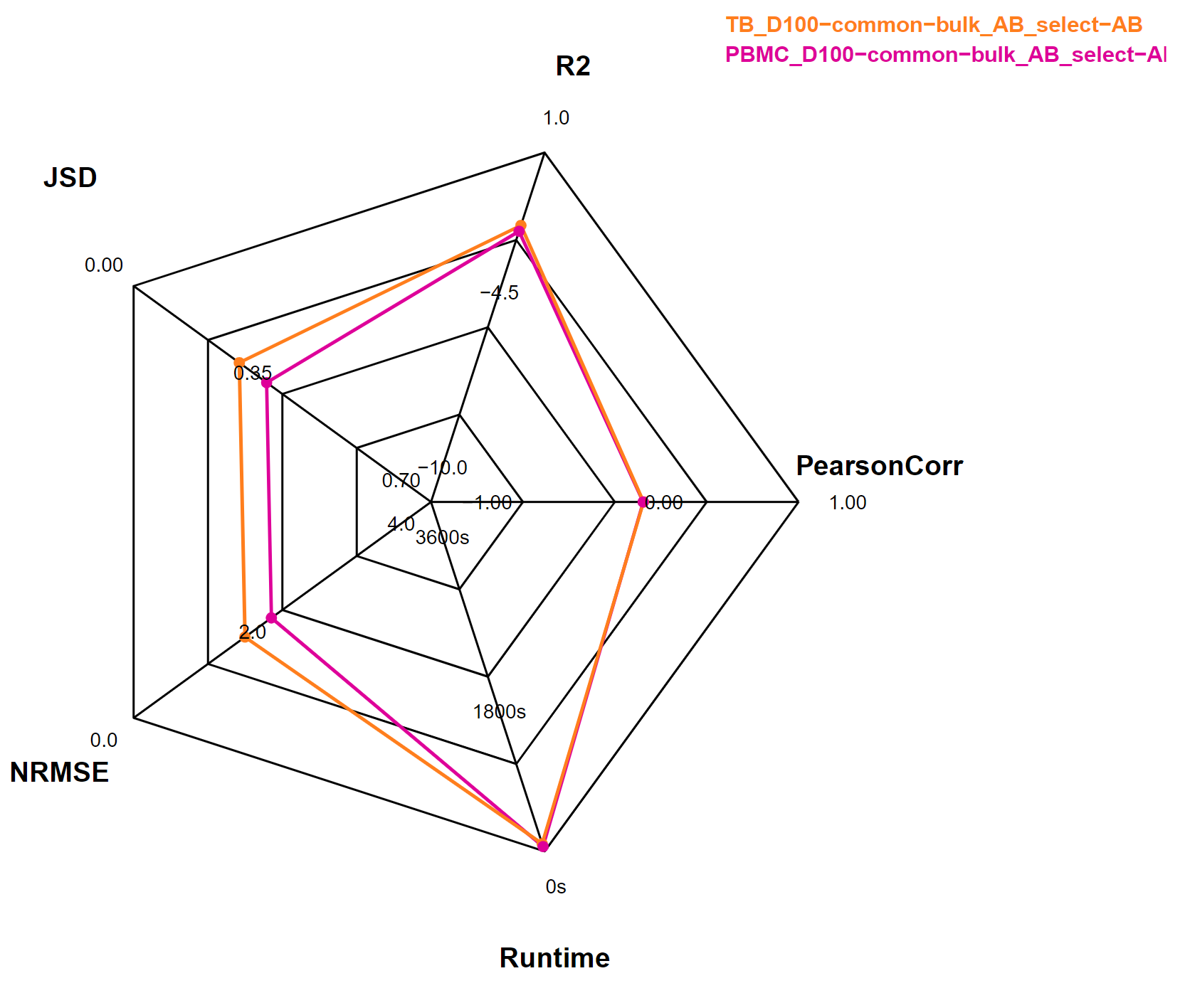
What Impact of 3rd Party Reference ?
26
Notes:
source

Slide 27


Conclusion
Bulk quality: High impact
Reference quality & properties: Moderate impact
27
Notes:
Contetualize!

Slide 28
III-Choosing a Model
28
Notes:
Assess model’s sensitivity to bulk quality.

Slide 29
Pseudobulk Performance
RNA-Sieve results
29

Slide 30
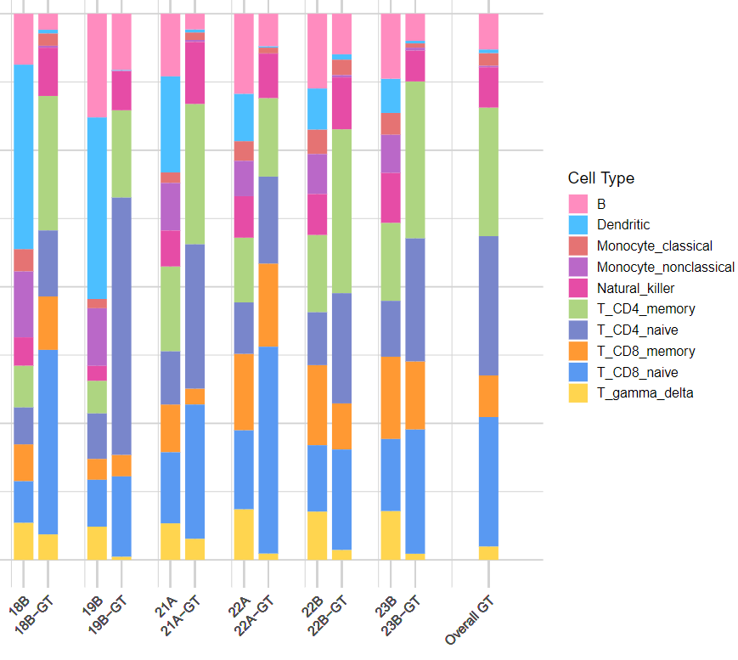
Bulk Performance
scaden results
30

Slide 31


Random Bulk Performance
31

Slide 32

Next Steps
Performance enhancement:
Bulk to Pseudobulk prediction
(Subtract known extra cellular data/noise + ML)
Optimal custom reference generation
(Cell expression from atlas, number of cells, etc.)
32

Slide 33

Next Steps
Further development:
Reference free model benchmarking
(Cell annotation issue)
Other datasets
(Answer ALS, etc.)
Per cell type benchmarking
Make it a user-friendly & updatable package
33

Slide 34
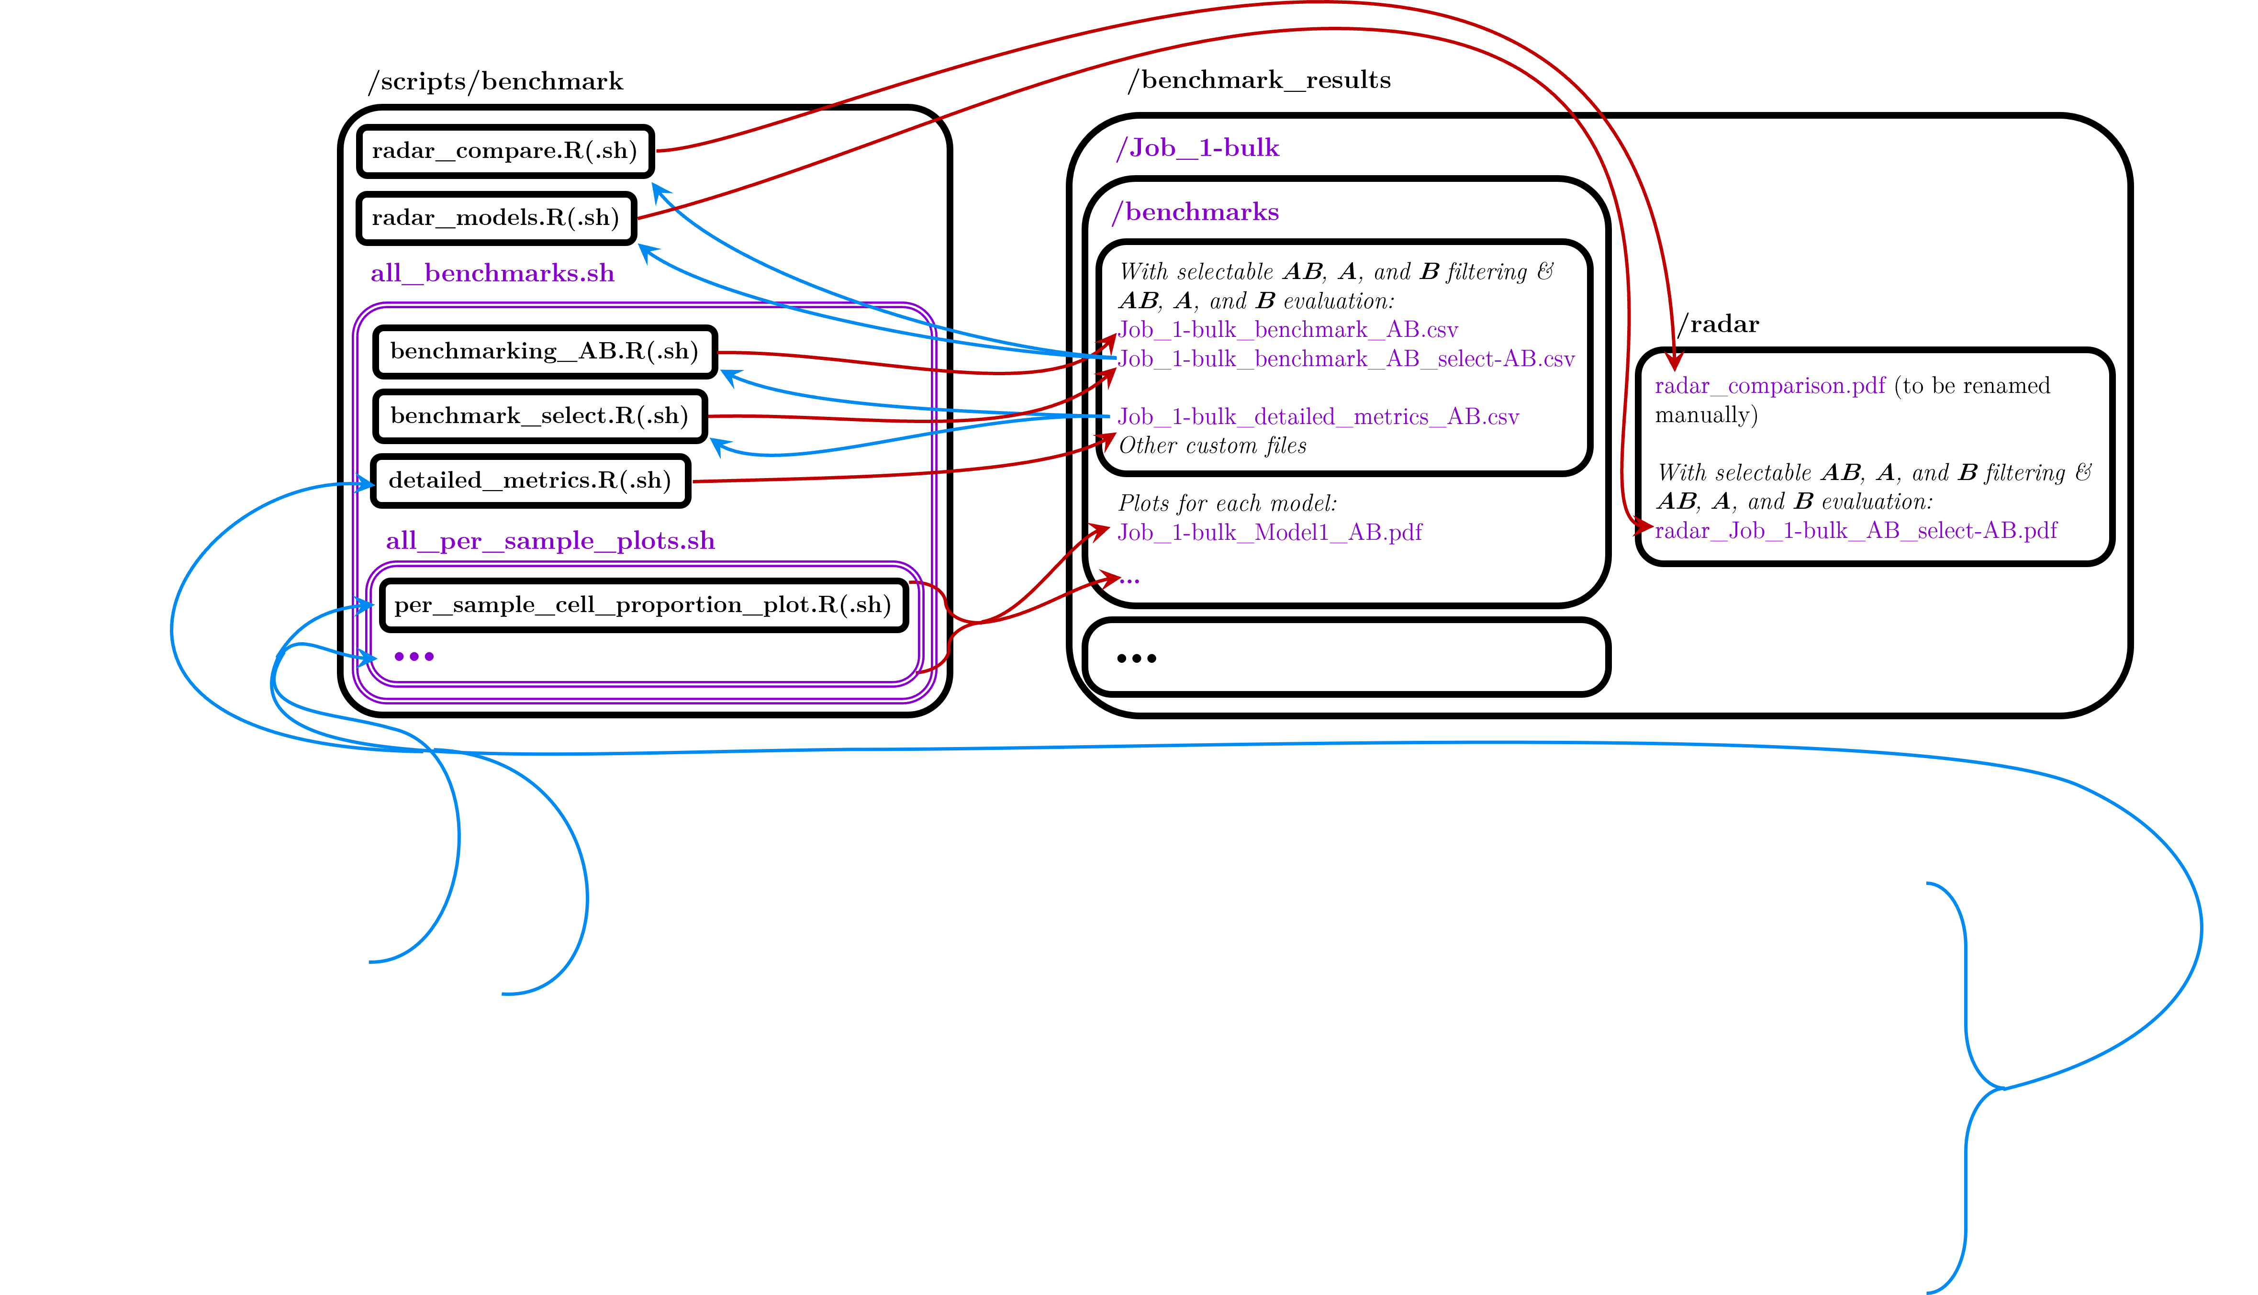
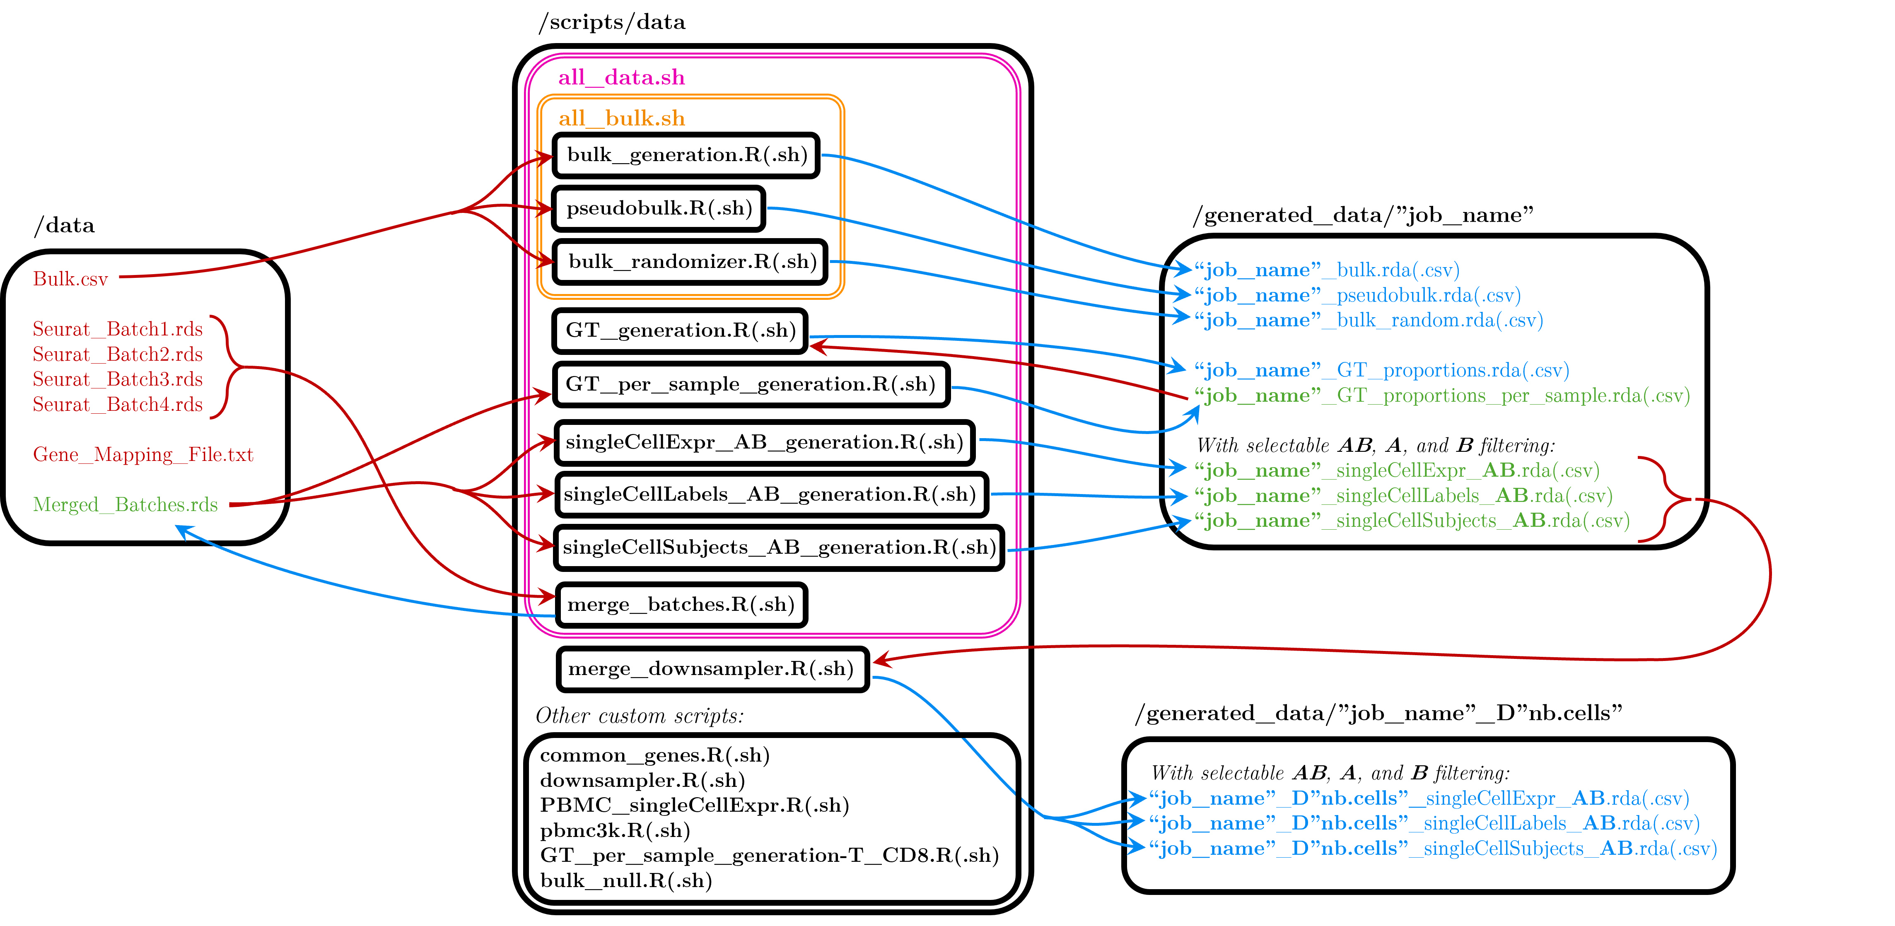
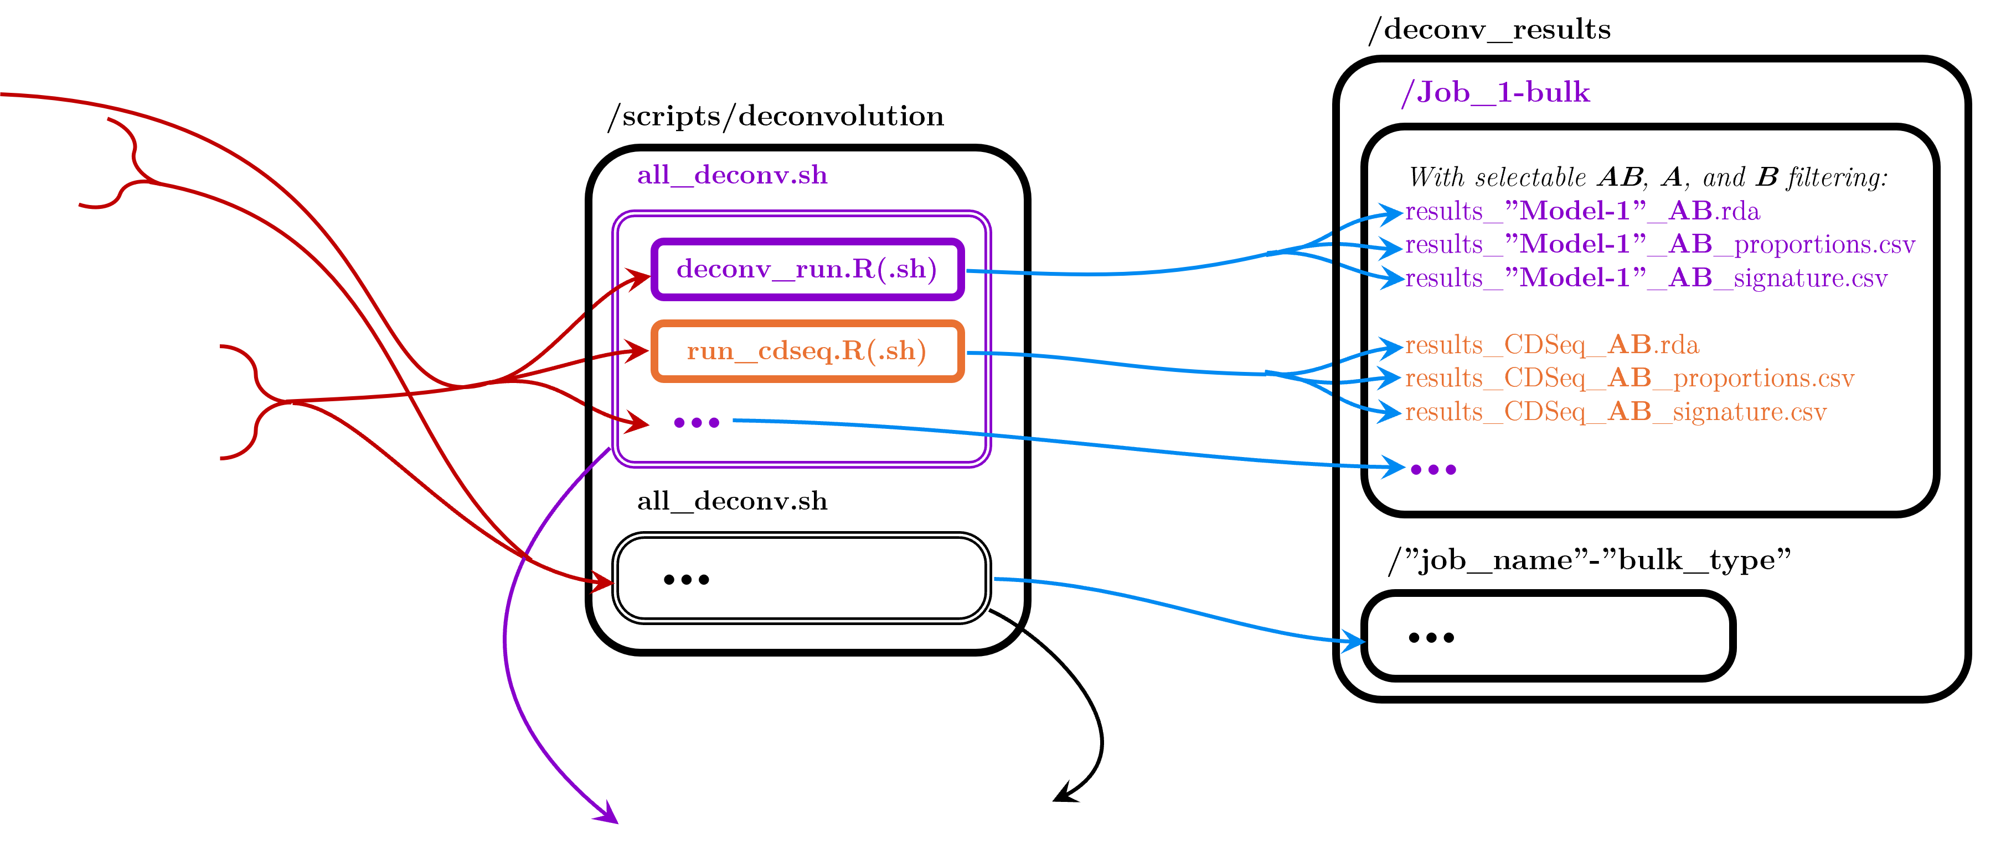
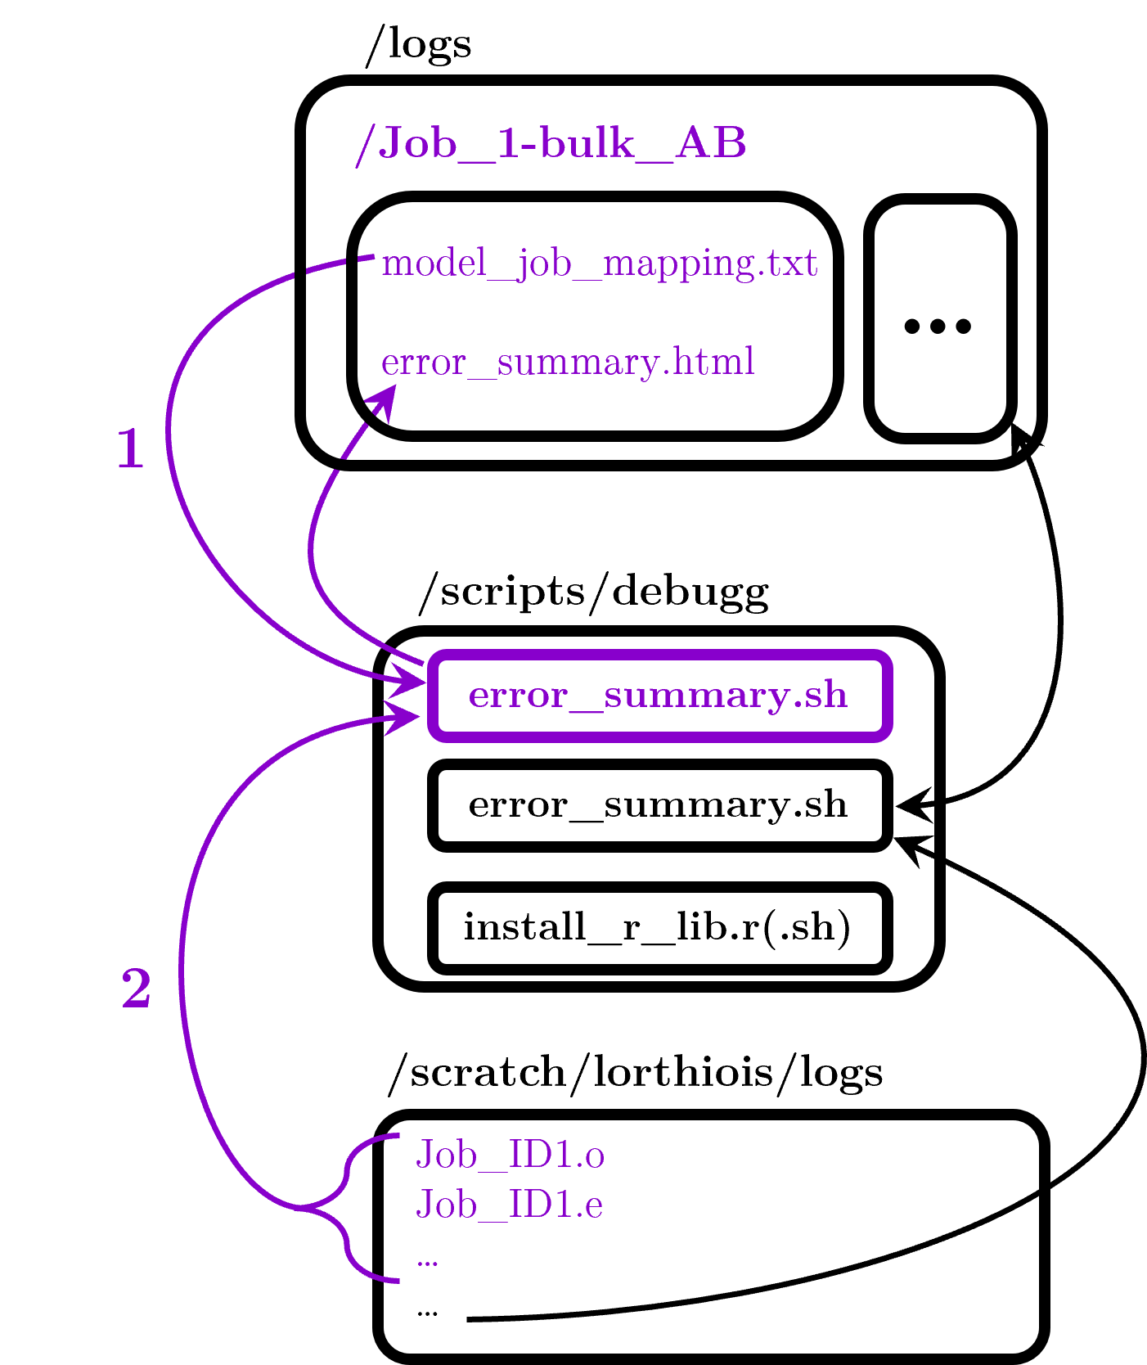
Flow Chart
(Slightly simplified)
For nearly every script:
error (.e) and output (.o) job files are saved at /scratch/lorthiois/logs
Base Directory: /work/gr-fe/lorthiois/DeconBenchmark
Repository: https://github.com/PierreLts/DeconBenchmark.git
34

Slide 35
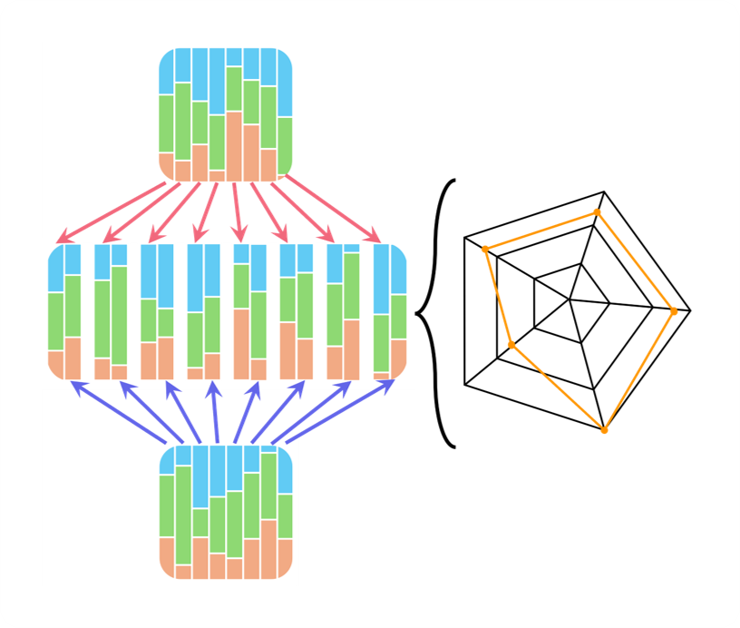
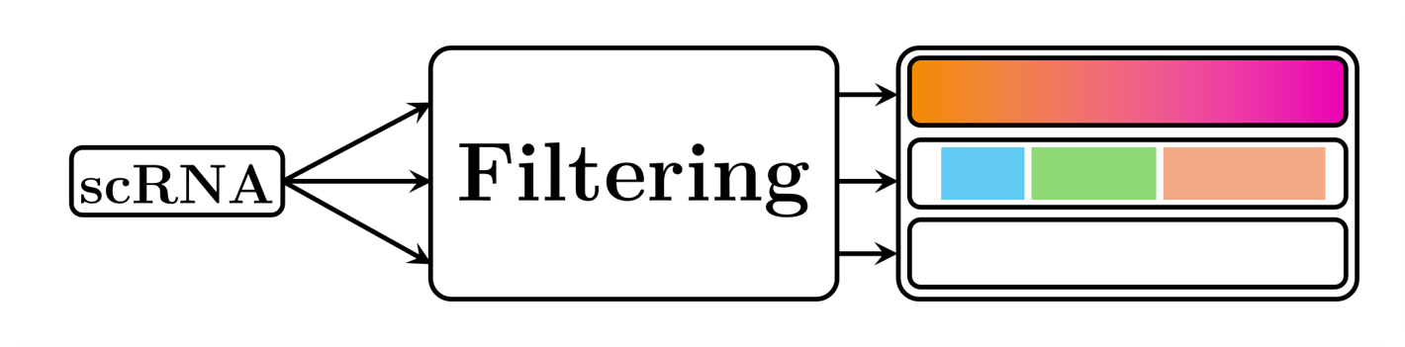
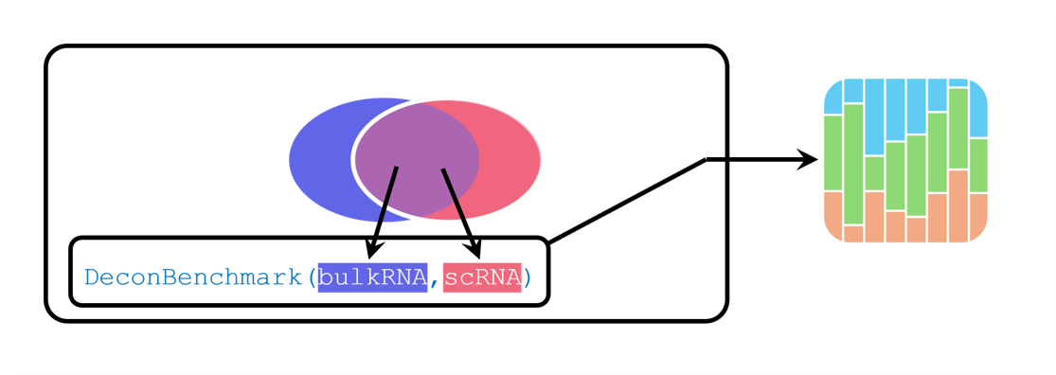
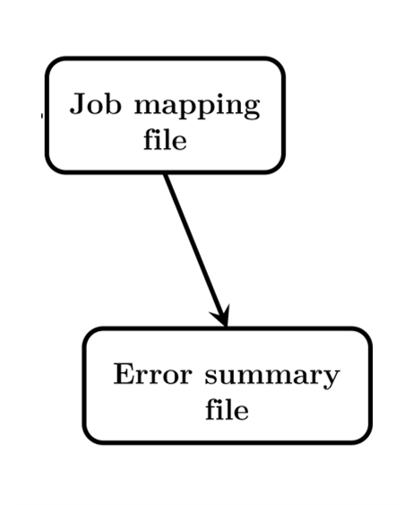
Flow Chart
35

Slide 36
Thank you
Jacques Fellay
Simon Tang
Simon Boutry
for the opportunity to work on this project with you.
And all members of the Fellay Lab for creating a welcoming research environment.
36

